Slide 1
CS489 Project Presentation Forus: A healthy debate platform
Team10 Inyong Koo, Minsu Kim

Slide 2
Overview

Slide 3
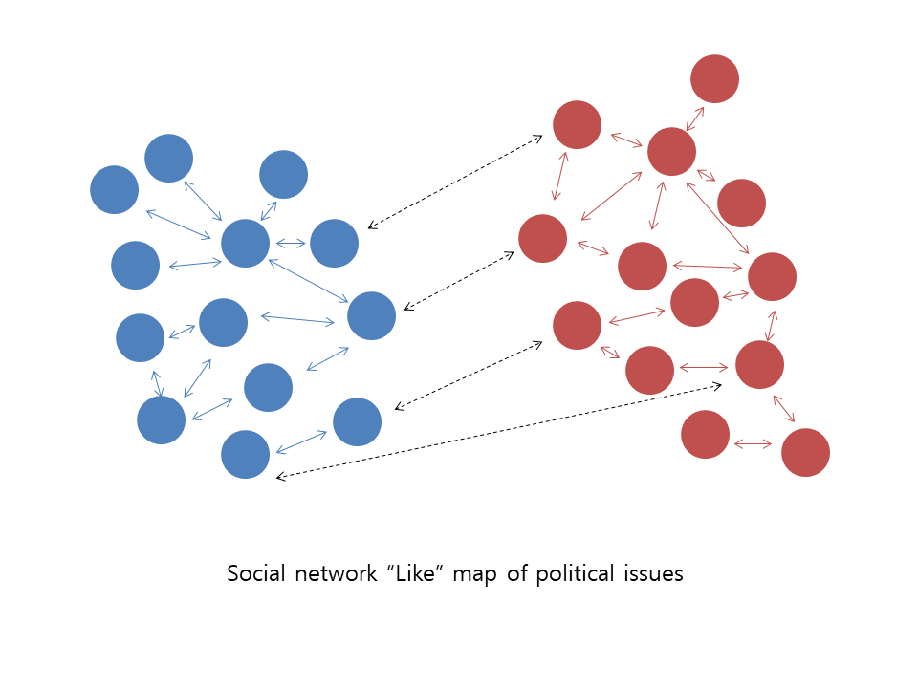
Social networks make people radical?
Friends and Followers
“Beliefs and world-views are reinforced by repetition inside a closed network of similarly-minded people”
Difficult to meet opposing ideas
Back to Tribalism
There are political clusters in social network
Platforms encourage this practice

Slide 4
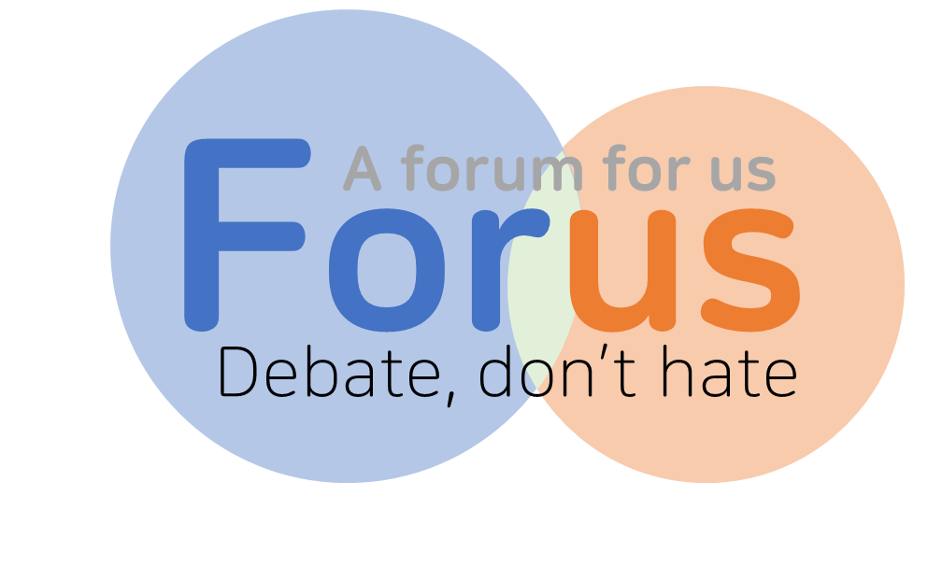
Our solution
A healthy debate platform to help you have a balanced view.
Notes:
We impose strict sanctions on swear words, disrespectful expressions and personal attacks

Slide 5
Listen to both sides
Topic “social networking and automated contents recommendation are
making people more radical”
My opinion Pros / Cons
See Opinions
I agree with this statement because ~~
I disagree with this statement because ~~
43 Approves from Cons
Fair enough!
61 Approves from Pros
Fair enough!
Notes:
Fair enough는 각 입장에 대해 논리적이라 생각하면 얼마든지 줄 수 있음. 찬반 중 하나를 선택할 경우 상대 진영의 의견에 대해서는 Approve로 count가 올라가나, 우리 진영에 대해서는 approve를 따로 표시하지 않음 (의견 올리는 순서에 대해서는 영향을 줄 수 있겠다.)

Slide 6
Make your side and meet challenges
Topic “social networking and automated contents recommendation are
making people more radical”
My opinion Pros
See Opinions
My Opinion I believe ~~~
3 Approves from Cons
I disagree with this statement because ~~
62 Approves from Pros
Add Objection
Fair enough!
I don’t think this statement is true because ~~
37 Approves from Pros
Add Objection
Fair enough!
Notes:
Fair enough는 각 입장에 대해 논리적이라 생각하면 얼마든지 줄 수 있음. 찬반 중 하나를 선택할 경우 상대 진영의 의견에 대해서는 Approve로 count가 올라가나, 우리 진영에 대해서는 approve를 따로 표시하지 않음 (의견 올리는 순서에 대해서는 영향을 줄 수 있겠다.)

Slide 7
Social networks make people radical?
We distinguish people with different ideas
You are more exposed to different ideas.
You can’t “like” ideas of your side
“Like” map of Forus

Slide 8
Implementation

Slide 9
Front-end Developing
It was our first time doing the “Front-end” development.
We had to learn many new things
HTML, CSS, JS
PHP
MySQL

Slide 10
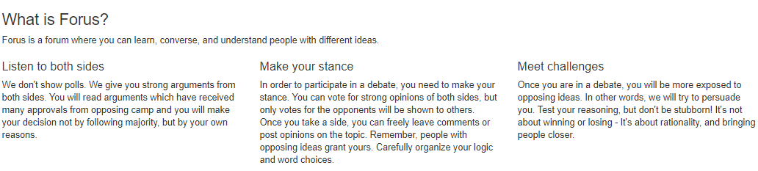

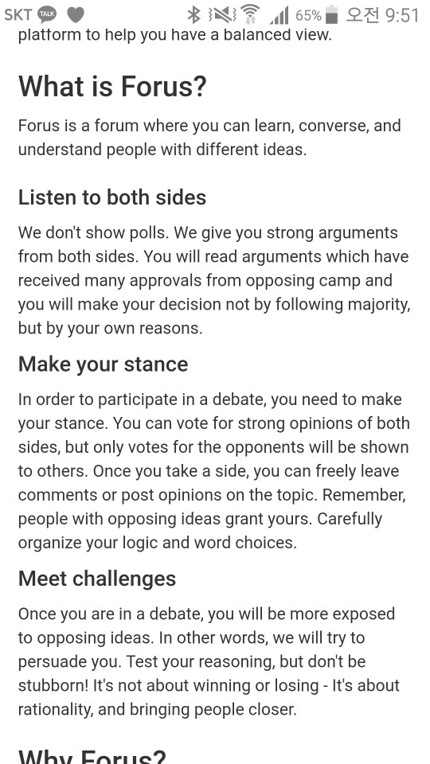
What we used - Boostrap
↑ on Web browser
← on Mobile device
Bootstrap
For designing stylish webpage
Adaptable layout for different surfaces

Slide 11




What we used – bitnami WAMP
HTTP web server
Database
bitnami WAMP
Windows Apache MySQL PHP
Dynamic webpage

Slide 12
Demo
http://110.76.74.76/home.php

Slide 13
Things to do
Like button
Comment
Profile
Edit / erase opinions
Add multiple opinions
Post issues
Feature implementation
Can’t use single quotation mark (‘)
Opinion not attached to right issue?
Bug Fix

Slide 14
User Survey
What is your primary interface for using social networks? (Android app, IOS app, Homepage in mobile, Homepage in computer)
Do you think social networks make people radical?(Agree or Disagree)
(1) Reason to agree?
(2) Reason to disagree?
Do you think Forus new recommendation system can solve clustering problem in political issues?(Yes or No)
(1) Why do you think that Forus cannot solve the problem? (Only answer If he or she choose “No” in problem 2)
Do you think people have been divided politically and ideologically in recent years?
Are you interested in using Forus if it is complete?(Yes or No)
(1) Why?
(2) Why not?
Forus has problem with a. interface and design b. main concept c. lack of hooks(not fun), d etc.
(1) What is the problem?(only if he or she choose d.etc)
7. (Optional) Please give us ideas for improving Forus

Slide 15
Thank You

